Slide 1
Skin Scrapings Examination
BY :
Dr. Katherine Bander

Slide 2
A. Skin Scrapings Examination
Skin scrapings are examined for the recovery of parasitic mites. The scraping must be obtained in a manner that takes into account both the nature of the lesion and location of the mites. These should be taken from moist part near the edge of the lesion a voiding the inclusion of large amount of dry crust, hair or wool. local anesthesia may be used for aggressive animals.

Slide 3
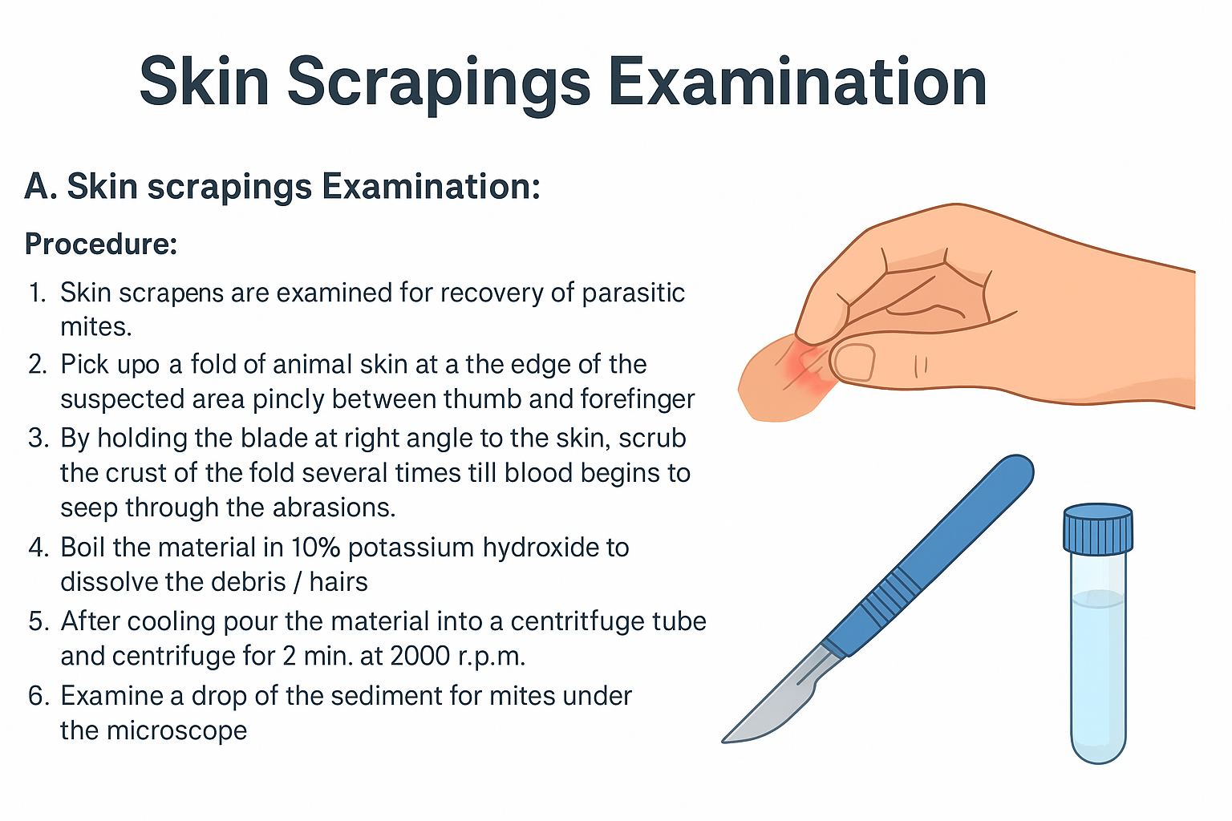

Slide 4

B. Nasal Scrapings Examination
This sample usually obtained by a rotatory motion of a spatula in the nasal tract. The fresh nasal discharge collected from the suspected animals in normal saline solution, then centrifuged at 1500 r.p.m.
for 5min. and the sediment is
examined under low power
of microscope.

Slide 5

Sputum Examination
Sputum specimens should be a deep sputum rather than primarily saliva, and it should be delivered immediately to the laboratory. Microscopic examination should include saline wet-mount and permanent stain preparation.
This sample can detect occasionally, intestinal parasites such as larvae of Ascaris species, Strongyloides species and hookworm ; cestode hooklets; and intestinal protozoa such as E. histolytica.

Slide 6
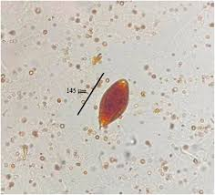

Urine Examination
Examination of urine specimens may be useful in diagnosing of Schistosoma haematobium eggs. The important portion of the urine is the last few drops of it because the eggs may be trapped in the mucus or pus and are more frequently in this portion of the urine. the sample centrifuged and the sediment examined under microscope
Schistosoma haematobium eggs.

Slide 7
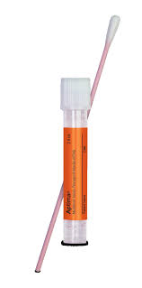
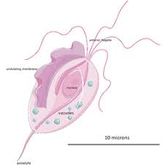
Urogenital Examination
Urogenital specimens are collected if infection with Trichomonas vaginalis is suspected. Identification is based on wet-mount preparation examination of vaginal and urethral discharges, prostatic secretion, or urine sediment. Specimens should be placed in a container with a small amount of 0.85% saline and sent immediately to the laboratory for examination.
Trichomonas vaginalis

Slide 8


